Slide 1
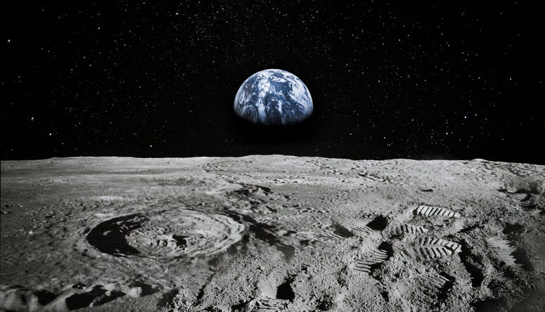
LUNAR LANDING PAYLOAD CRANE
Alanna Black | Jayson Dickinson | Christina Morrow | Ryker Mullinix
TEAM 517

Slide 2
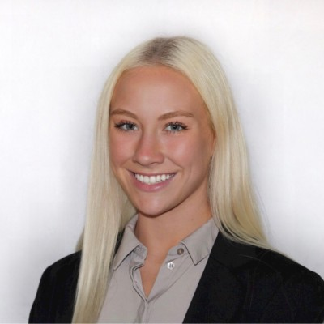



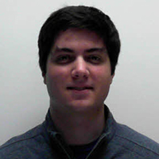
Meet Team 517
Alanna Black
Jayson Dickinson
Christina Morrow
Ryker Mullinix
Robotics &
Controls Engineer
Project Manager &
Fluid Dynamics Engineer
Design & Test
Engineer
Materials Engineer
Alanna Black

Slide 3
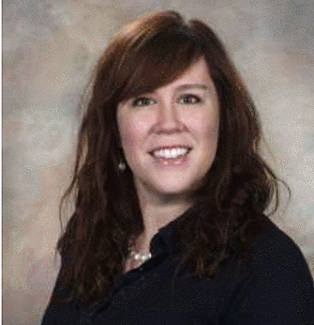
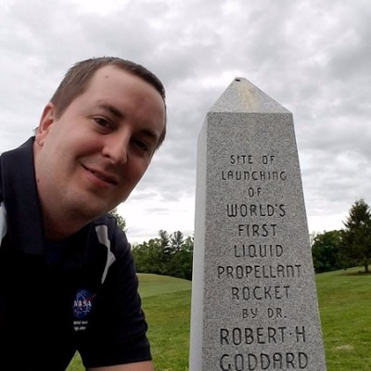

Sponsor & Advisor
Rachel McCauley
Justin Rowe
Dr. Eric Hellstrom
NASA Marshall Space
Flight Center
NASA Marshall Space
Flight Center
FAMU-FSU
College of Engineering
Alanna Black

Slide 4




Project Objective
The objective of this project is to offload the LSMS (Lightweight Surface Manipulation System) from the CLPS (Commercial Lunar Payload Services) lander onto a platform.
Alanna Black

Slide 5




Project Background
NASA Plans for
Lunar Base
NASA Developed Payload Crane
v
v
Artemis Mission
Announced
Design Payload Crane Off-loader
Alanna Black

Slide 6

Motivation
Alanna Black

Slide 7
Motivation
Alanna Black

Slide 8
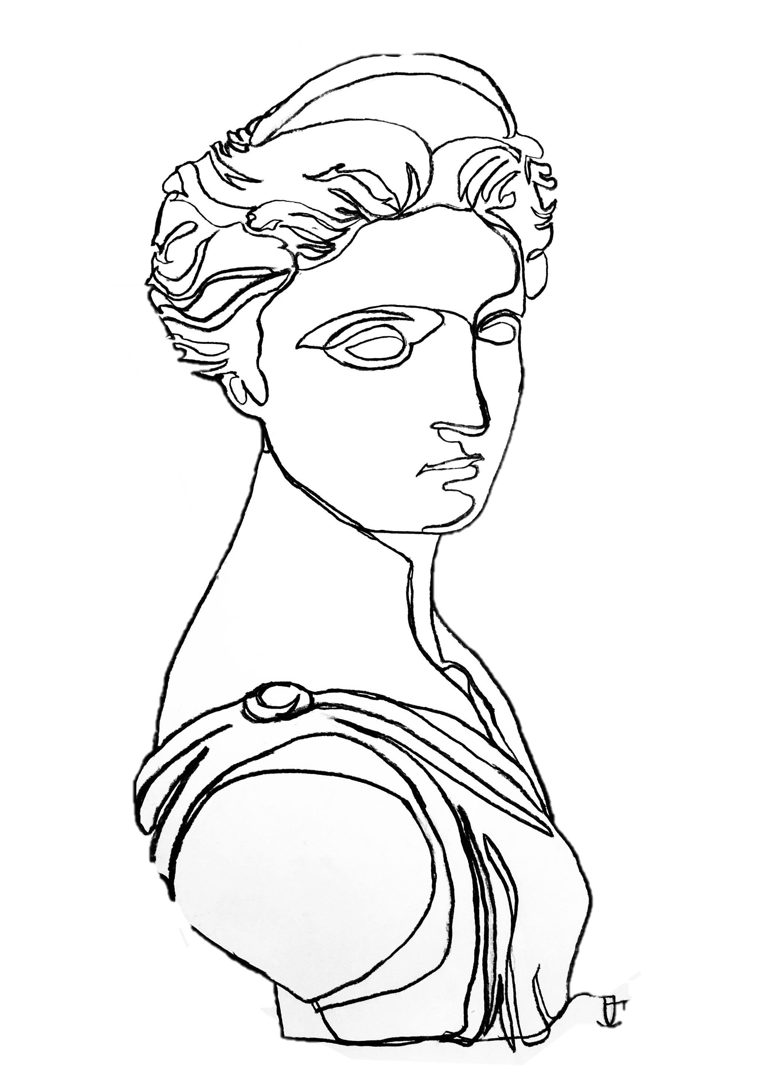


Artemis Background
Goddess of the Hunt
Alanna Black

Slide 9

Artemis Background
Goddess of the Hunt
Artemis Program Patch
Alanna Black

Slide 10
A
R
R
O
W
AUTOMATED AND RANGED RELOCATION OF THE LSMS FOR WIDER APPLICATION
Alanna Black

Slide 11
Assumptions
Project Scope
LSMS CAN DOCK TO LUNAR PLATFORM
THE ARROW HAS ACCESS TO POWER VIA THE CLPS LANDER
LSMS WILL SEND READY SIGNAL TO ARROW
REUSABILITY IS NOT A CONCERN
Alanna Black

Slide 12
Assumptions
Project Scope
ENVIROMENTAL FACTORS ARE
NOT A CONCERN
LSMS AND ARROW LOCATION ON
LANDER ARE AT THE DISCRETION
OF THE DESIGN TEAM
IN-SPACE ASSEMBLY AND IN-SPACE EXTRA-VEHICULAR ACTIVITY (EVA)
WILL NOT BE REQUIRED.
WEIGHT OF MINI LSMS IS 25% OF
LIFTING CAPABILITY AT THE WRIST.
Alanna Black
Notes:
This number is normally 3% but for the mini LSMS, it wouldn’t make sense to use that percentage of weight to lifting capability because that would result in a weight of 3 lbs or 6 kg, which is not realistic. Speaking to our sponsor about this he said it would be more appropriate to assume between 25-30%

Slide 13

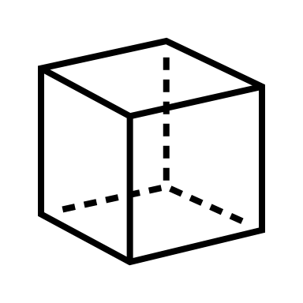

Key Goals
AUTONOMY
OFFLOAD LSMS
SCALABILITY
Alanna Black

Slide 14




Targets & Metrics
MOTION
COMMUNICATION
POWER
SUPPORT
Alanna Black

Slide 15

Targets & Metrics
z
X-AXIS
Y-AXIS
Z-AXIS
Move about Axes
0°
44°
90°
x
Relocate the LSMS
0.525 m
0.225 m
0.231 m
y
Alanna Black

Slide 16
Targets & Metrics
Decrease LSMS
Position Error
±2.54 cm
±10 deg
Secure LSMS
41 N
Release LSMS
±2.54 cm
Scale for Variable
LSMS Size
1:1
Alanna Black

Slide 17
Targets & Metrics
Decrease LSMS
Position Error
±2.54 cm
±10 deg
Secure LSMS
41 N
Release LSMS
±2.54 cm
Scale for Variable
LSMS Size
1:1
Alanna Black

Slide 18
Targets & Metrics
Decrease LSMS
Position Error
±2.54 cm
±10 deg
Secure LSMS
41 N
Release LSMS
±2.54 cm
Scale for Variable
LSMS Size
1:1
Alanna Black

Slide 19
Targets & Metrics
Decrease LSMS
Position Error
±2.54 cm
±10 deg
Secure LSMS
41 N
Release LSMS
±2.54 cm
Scale for Variable
LSMS Size
1:1
Alanna Black

Slide 20


Targets & Metrics
Receive Power
1800 Watts
Convert Power to Torque
33 Nm
Alanna Black

Slide 21

Targets & Metrics
Receive Power
1800 Watts
Convert Power to Torque
33 Nm
Alanna Black

Slide 22
Targets & Metrics
Transmit Signal
2.4 GHz
Receive Signal
2.4 GHz
Transduce Signal
120 Volts
Process Signal
18 ms
Alanna Black

Slide 23





Concept Generation
Brainstorm
Morphological Chart
Biomimicry
Alanna Black

Slide 24
Medium Fidelity
Mating connector for the LSMS end-effector, located via plug connection
Four-bar Mechanism
Fingerlike end-effector that locates the LSMS via RFID
Winch attached to the Chariot mobility chassis
Scissor-lift Platform
01
02
03
04
05
Alanna Black

Slide 25
High Fidelity
Lazy SUSAN
Fingerlike
End-Effector
Acrobat LSMS
Alanna Black
Notes:
Lazy susan – including a gear box and connector pins
Fingerlike end effector – uses laser technology

Slide 26



Concept Selection
Pairwise
Comparison
Pugh Chart
+
S
House of
Quality
Analytical
Hierarchy
Process
Jayson Dickinson
Notes:
Slide idea was taken from https://poweredtemplate.com/four-steps-hiring-process-75689/
So we took these 8 design concepts, the 5 medium and 3 high fidelity and sent them through an iterative concept selection process.
PC – determing the importance weight factor of each of our engineering characteristics
HoQ – we used those weight factors to ranking our engineering characteristics
Pugh – used to elimate concepts compared to a relatively neutral datum
AHP – used to help identify and eliminate bias as well as find our best alternative design

Slide 27


Concept Selection
Priority Characteristics
AUTONOMY
SCALABILITY
WEIGHT
Jayson Dickinson
Notes:
It’s worth mentioning that our priority characteristics were found to be autonomy, scalability, and weight.
These really influenced the decision making.

Slide 28
High Fidelity
Lazy SUSAN
Jayson Dickinson

Slide 29
High Fidelity
Lazy SUSAN
Jayson Dickinson

Slide 30
High Fidelity
Lazy SUSAN
Jayson Dickinson

Slide 31
High Fidelity
Lazy SUSAN
Jayson Dickinson

Slide 32
High Fidelity
Lazy SUSAN
Jayson Dickinson

Slide 33
High Fidelity
Lazy SUSAN
Jayson Dickinson

Slide 34
High Fidelity
Lazy SUSAN
Jayson Dickinson

Slide 35
Free Body Diagram
SHOULDER
Forearm 0.65 Nm
FOREARM
Shoulder 5.77 Nm
KINGPOST
Kingpost 19.0-26.6 Nm
Jayson Dickinson

Slide 36
Free Body Diagram
Initial Position Worst Case Scenario Position
Forearm 0.65 Nm
SHOULDER
FOREARM
Shoulder 5.77 Nm
KINGPOST
Kingpost 19.0-26.6 Nm
0.93 m
Jayson Dickinson

Slide 37
Free Body Diagram
Initial Position Worst Case Scenario Position
SHOULDER
Forearm 0.65 Nm
FOREARM
Shoulder 5.77 Nm
KINGPOST
Kingpost 19.0-26.6 Nm
Jayson Dickinson

Slide 38
Free Body Diagram
Initial Position Worst Case Scenario Position
SHOULDER
KINGPOST
Forearm 0.65 Nm
FOREARM
Shoulder 5.77 Nm
Kingpost 19.0-26.6 Nm
2.58 m
Jayson Dickinson

Slide 39

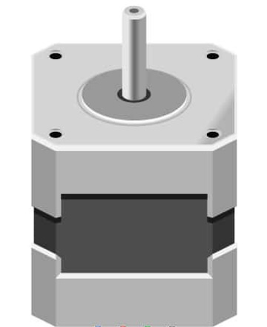
Design Iterations
Stepper Motor
Spiral Spring
Extension Spring
Linear Actuator
Jayson Dickinson

Slide 40
Design Iterations
Stepper Motor
Spiral Spring
Extension Spring
Linear Actuator
Jayson Dickinson

Slide 41
Design Iterations
Stepper Motor
Spiral Spring
Extension Spring
Linear Actuator
Jayson Dickinson

Slide 42
Design Iterations
Stepper Motor
Spiral Spring
Extension Spring
Linear Actuator
Jayson Dickinson

Slide 43
Current Design
Turntable Mechanism
Jayson Dickinson

Slide 44
Current Design
Turntable Mechanism
Linear Actuator
Jayson Dickinson

Slide 45

Current Design
Turntable Mechanism
Linear Actuator
Z-Axis 90° Rotation
Jayson Dickinson

Slide 46
Current Design
Turntable Mechanism
Linear Actuator
Z-Axis 90° Rotation
Jayson Dickinson

Slide 47
Current Design
Turntable Mechanism
Linear Actuator
Z-Axis 90° Rotation
Jayson Dickinson

Slide 48
Current Design
Turntable Mechanism
Linear Actuator
Linear Actuator
Z-Axis 90° Rotation
Rack Length: 0.048 m
Jayson Dickinson

Slide 49
Current Design
Pivot Mechanism
Linear Actuator
Jayson Dickinson

Slide 50

Current Design
Pivot Mechanism
Linear Actuator
Pin Connection
Jayson Dickinson

Slide 51
Current Design
Pivot Mechanism
Linear Actuator
Pin Connection
Y-Axis 44° Rotation
Jayson Dickinson

Slide 52





Future Work
ORDER PARTS
ASSEMBLY
TESTING
Jayson Dickinson

Slide 53
Timeline
Spring Semester Timeline
VDR3
CAD
Automation
VDR4
3D Printing
Prototyping
Testing
Presentation
January
February
March
April
May
Jayson Dickinson

Slide 54




TEAM 517
Alanna Black
anb16c@my.fsu.edu
Jayson Dickinson
jpd15e@my.fsu.edu
LUNAR LANDING PAYLOAD CRANE
Christina Morrow
cjm18bn@my.fsu.edu
Ryker Mullinix
rwm18c@my.fsu.edu

Slide 55
References
Dorsey, J., Jones, T., Doggett, W., King, B., Mercer, C., Brady, J., . . . Ganoe, G. (2011). Recent Developments in the Design, Capabilities and Autonomous Operations of a Lightweight Surface Manipulation System and Test-bed. AIAA SPACE 2011 Conference & Exposition. doi:10.2514/6.2011-7266
Doggett, W. (., King, B., Jones, T., Dorsey, J., & Mikulas, M. (2008). Design and Field Test of a Mass Efficient Crane for Lunar Payload Handling and Inspection: The Lunar Surface Manipulation System. AIAA SPACE 2008 Conference & Exposition. doi:10.2514/6.2008-7635
PEREGRINE LUNAR LANDER: PAYLOAD USER’S GUIDE [PDF]. (2020, June). Astrobotic Technology.
Jefferies, S., Doggett, W., Chrone, J., Angster, S., Dorsey, J., Jones, T., . . . Caldwell, D. (2010). Lunar Lander Offloading Operations Using a Heavy-Lift Lunar Surface Manipulator System. AIAA SPACE 2010 Conference & Exposition. doi:10.2514/6.2010-8804
Dorsey, J., Jones, T., Doggett, W., King, B., Mikulas, M., & Roithmayr, C. (2009). Developments to Increase the Performance, Operational Versatility and Automation of a Lunar Surface Manipulation System. AIAA SPACE 2009 Conference & Exposition. doi:10.2514/6.2009-6795
Dorsey, J., Mikulas, M., & Doggett, W. (2008). Preliminary Structural Design Considerations and Mass Efficiencies for Lunar Surface Manipulator Concepts. AIAA SPACE 2008 Conference & Exposition. doi:10.2514/6.2008-7916

Slide 56

Background Info - Artemis
Artemis Mission
Milestones:
Scheduled to Launch in 2023
Sending the next man and first woman to the moon
Major goal is to set up a lunar base
Photos from nasa.gov
1/2

Slide 57
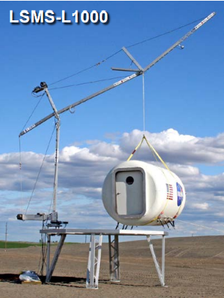
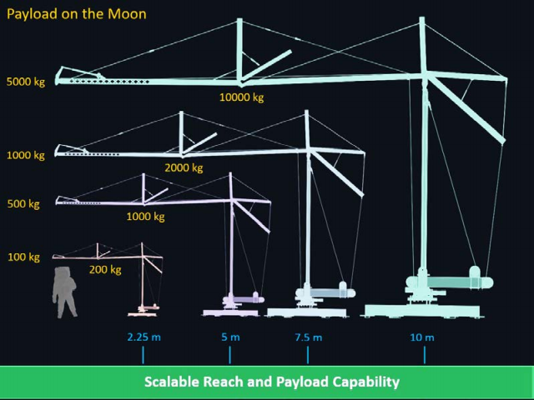
Background Info - LSMS
Versatile and Multi-Functional:
Precision Payload Lifting / Unloading
Large-Scale 3-D Printing
Assembly, and Regolith Excavation and Handling
Astronaut Elevator
Deploying Structures + Science
Connections, E-Beam Welding
NASA LSMS Crane
Info and Photos from NASA Presentation Given by Tom Jones
2/2

Slide 58
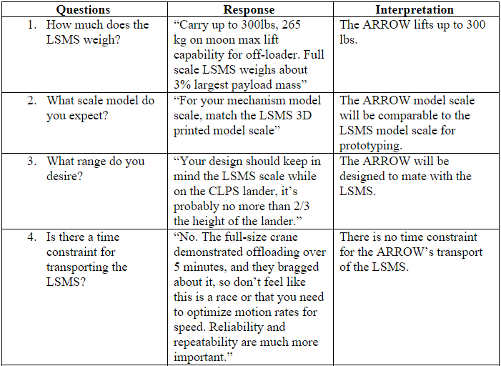
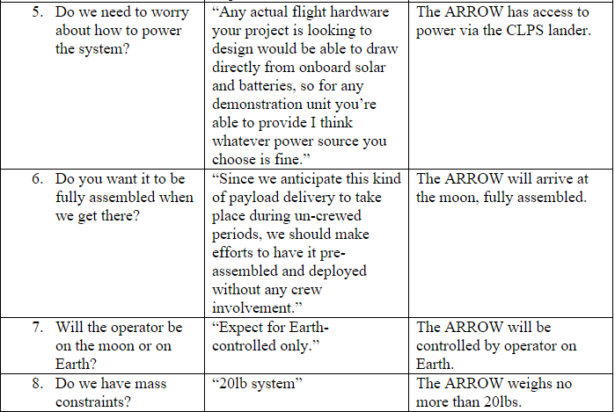
Customer Needs
1/3

Slide 59
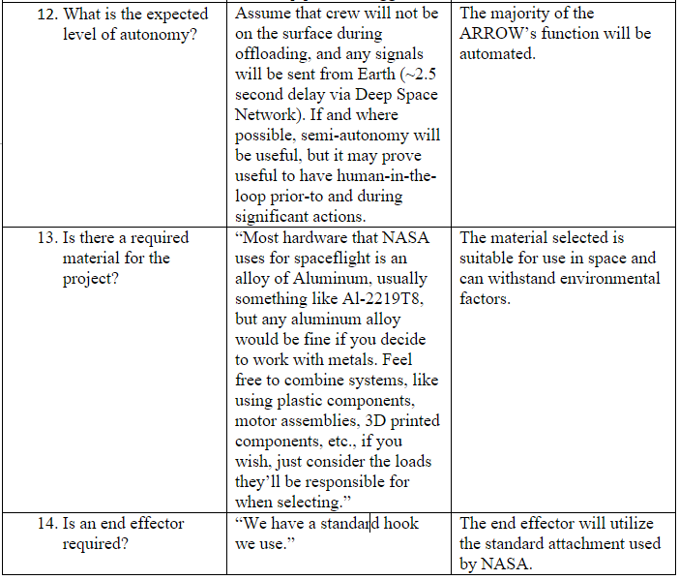
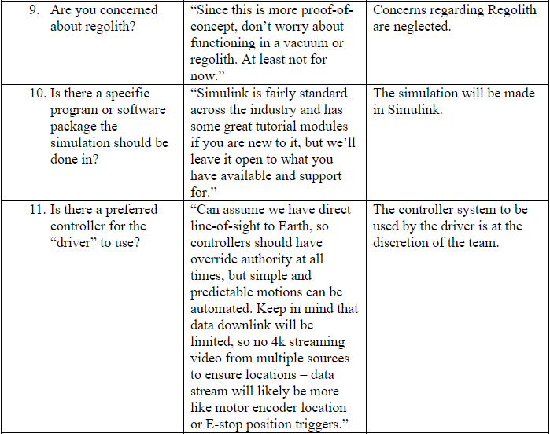
Customer Needs
2/3

Slide 60




Customer Needs
How much does the LSMS weigh?
Is there a time constraint for transporting the LSMS?
What is the expected level of autonomy?
What scale should be used?
The ARROW will lift up to 25 lbs.
There is no time constraint for transport of the LSMS.
Automation for offloading will be part of the landing sequence.
The ARROW will be scalable to mate with the LSMS.
3/3

Slide 61
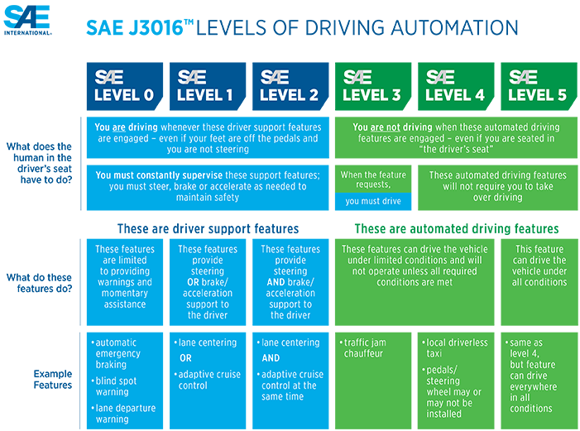

Key Goals – SAE Standards
1/1

Slide 62
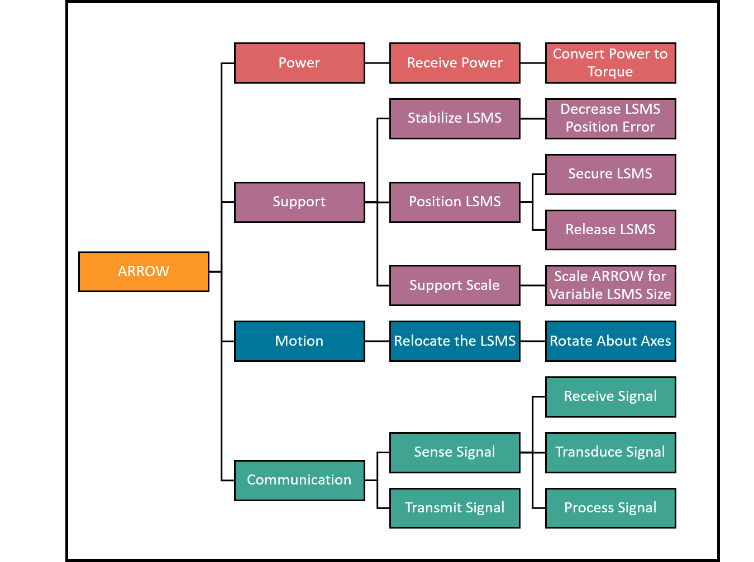
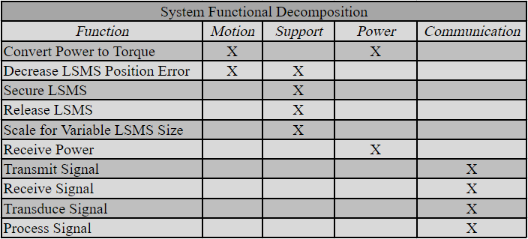
Functional Decomposition
Cross Reference Table
Hierarchy Flow Chart
1/2

Slide 63
Targets & Metrics
Shown in bold are the critical targets for this project.
2/2

Slide 64
High Fidelity
Fingerlike
End-Effector
Name

Slide 65
High Fidelity
Fingerlike
End-Effector
Name

Slide 66
High Fidelity
Fingerlike
End-Effector
Name

Slide 67
High Fidelity
Fingerlike
End-Effector
Name

Slide 68
High Fidelity
Fingerlike
End-Effector
Name

Slide 69
High Fidelity
Fingerlike
End-Effector
Name

Slide 70
High Fidelity
Acrobat LSMS
Name

Slide 71
High Fidelity
Acrobat LSMS
Name

Slide 72
High Fidelity
Acrobat LSMS
Name

Slide 73
High Fidelity
Acrobat LSMS
v

Slide 74
High Fidelity
Acrobat LSMS
Name

Slide 75
High Fidelity
Acrobat LSMS
Name

Slide 76
High Fidelity
Acrobat LSMS
Name

Slide 77
Concept Generation
1/8

Slide 78
Concept Selection
2/8

Slide 79
Concept Selection
3/8

Slide 80
Concept Selection
4/8

Slide 81
Concept Selection
5/8

Slide 82
Concept Selection
6/8

Slide 83
Concept Selection
7/8

Slide 84
Concept Selection
8/8

Slide 85
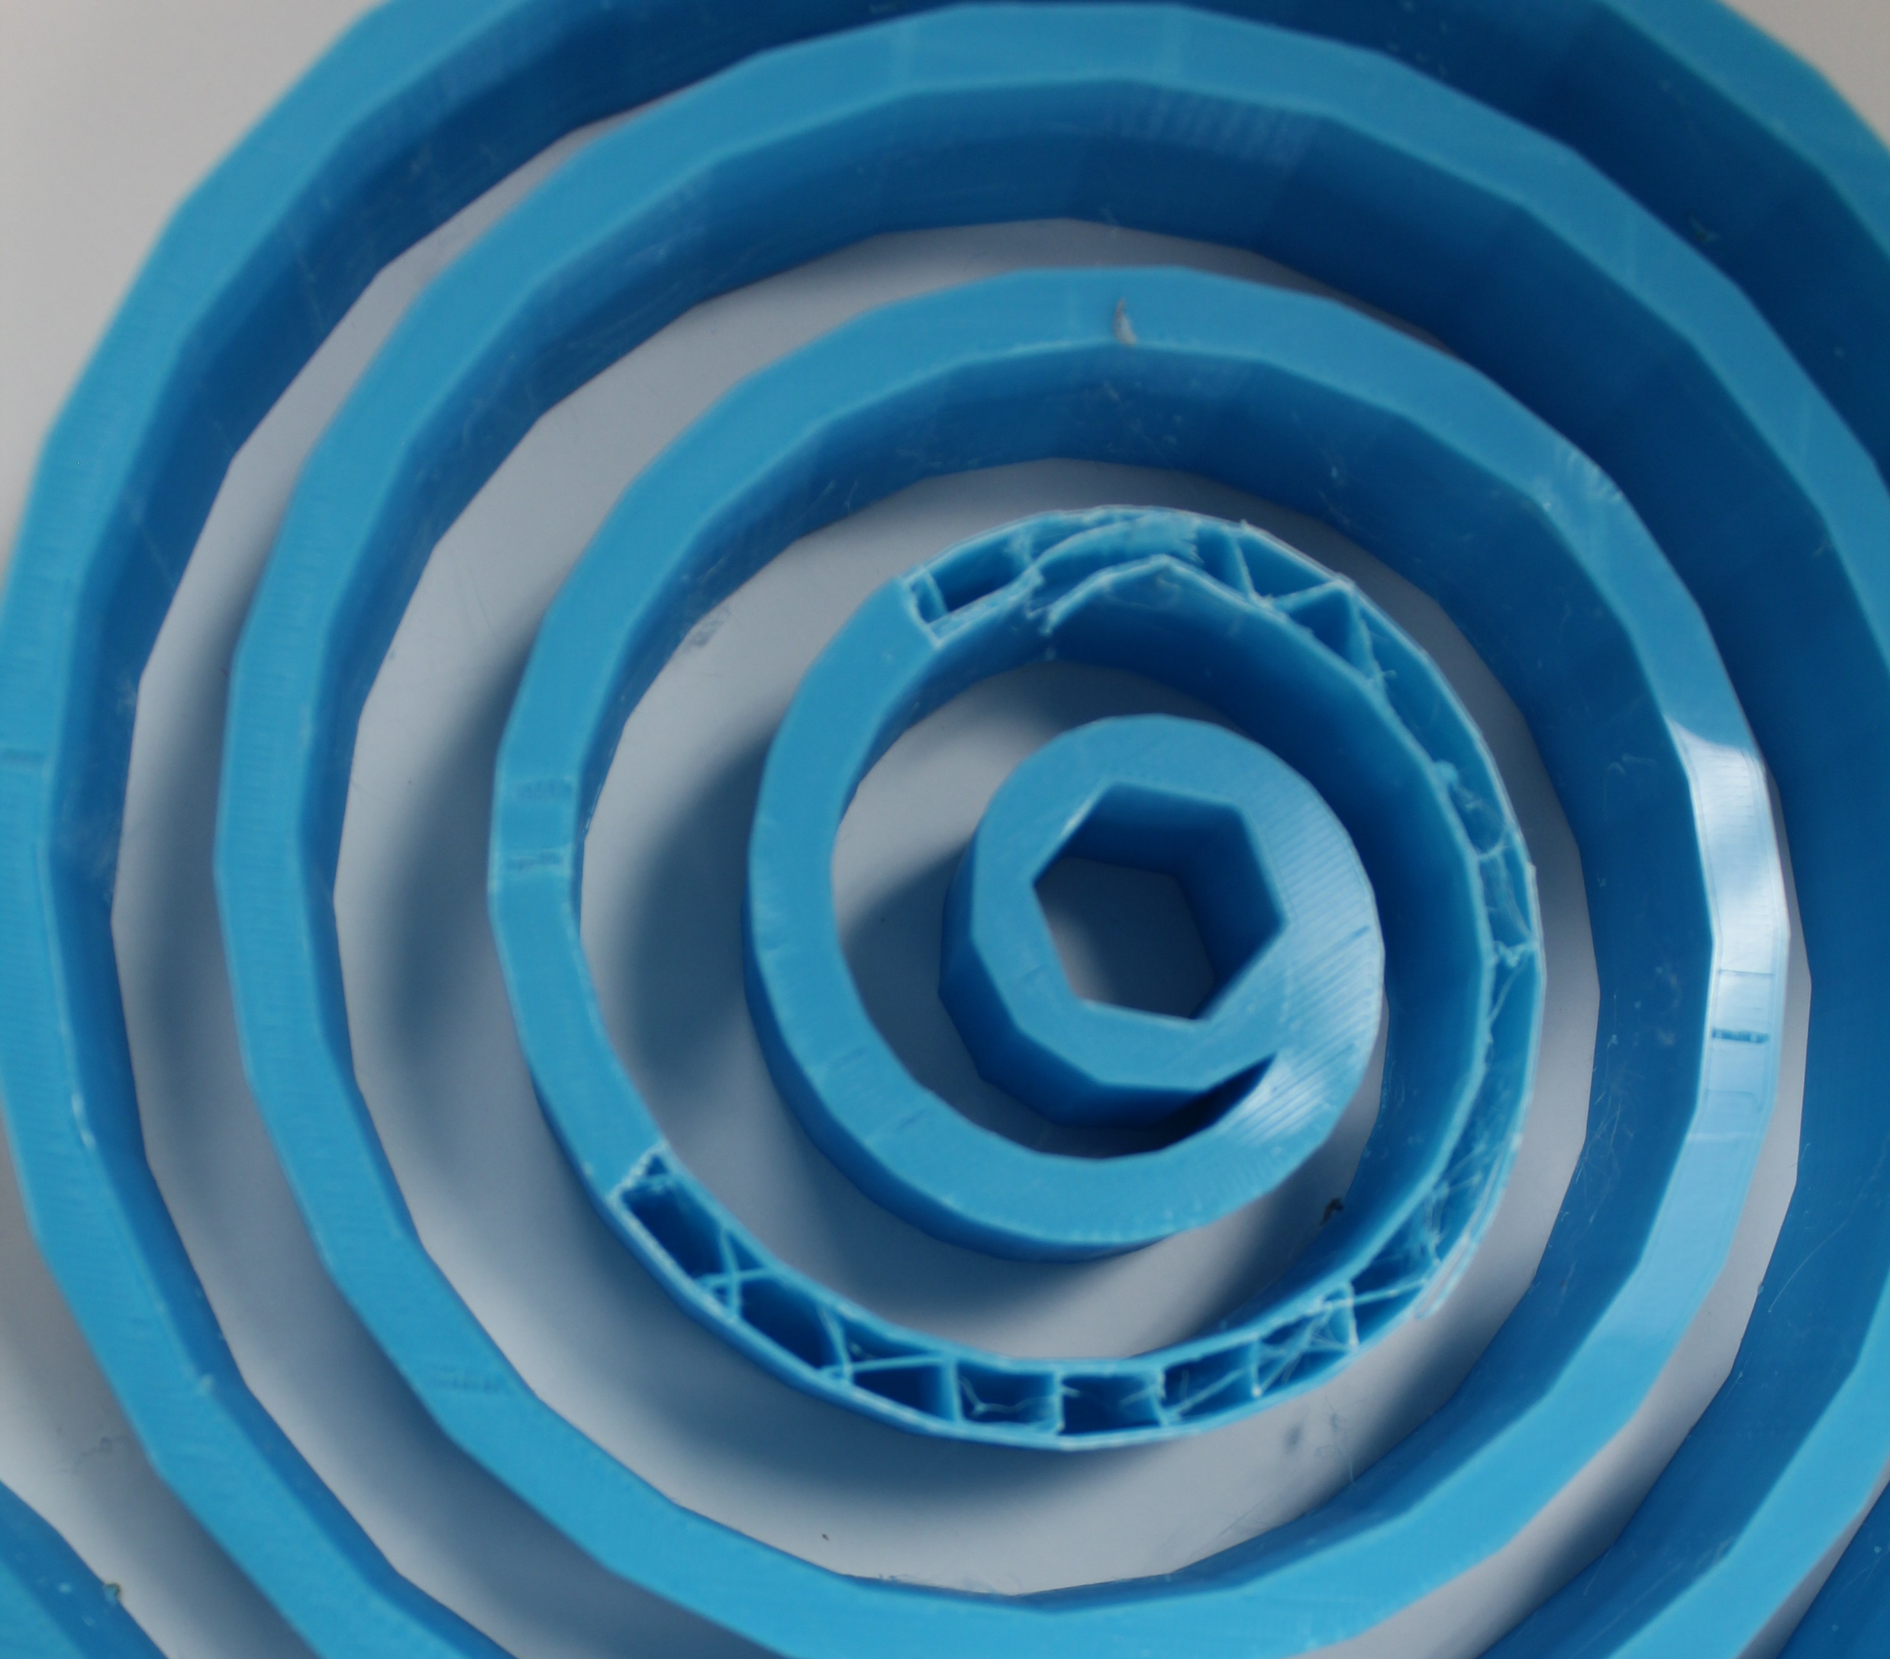
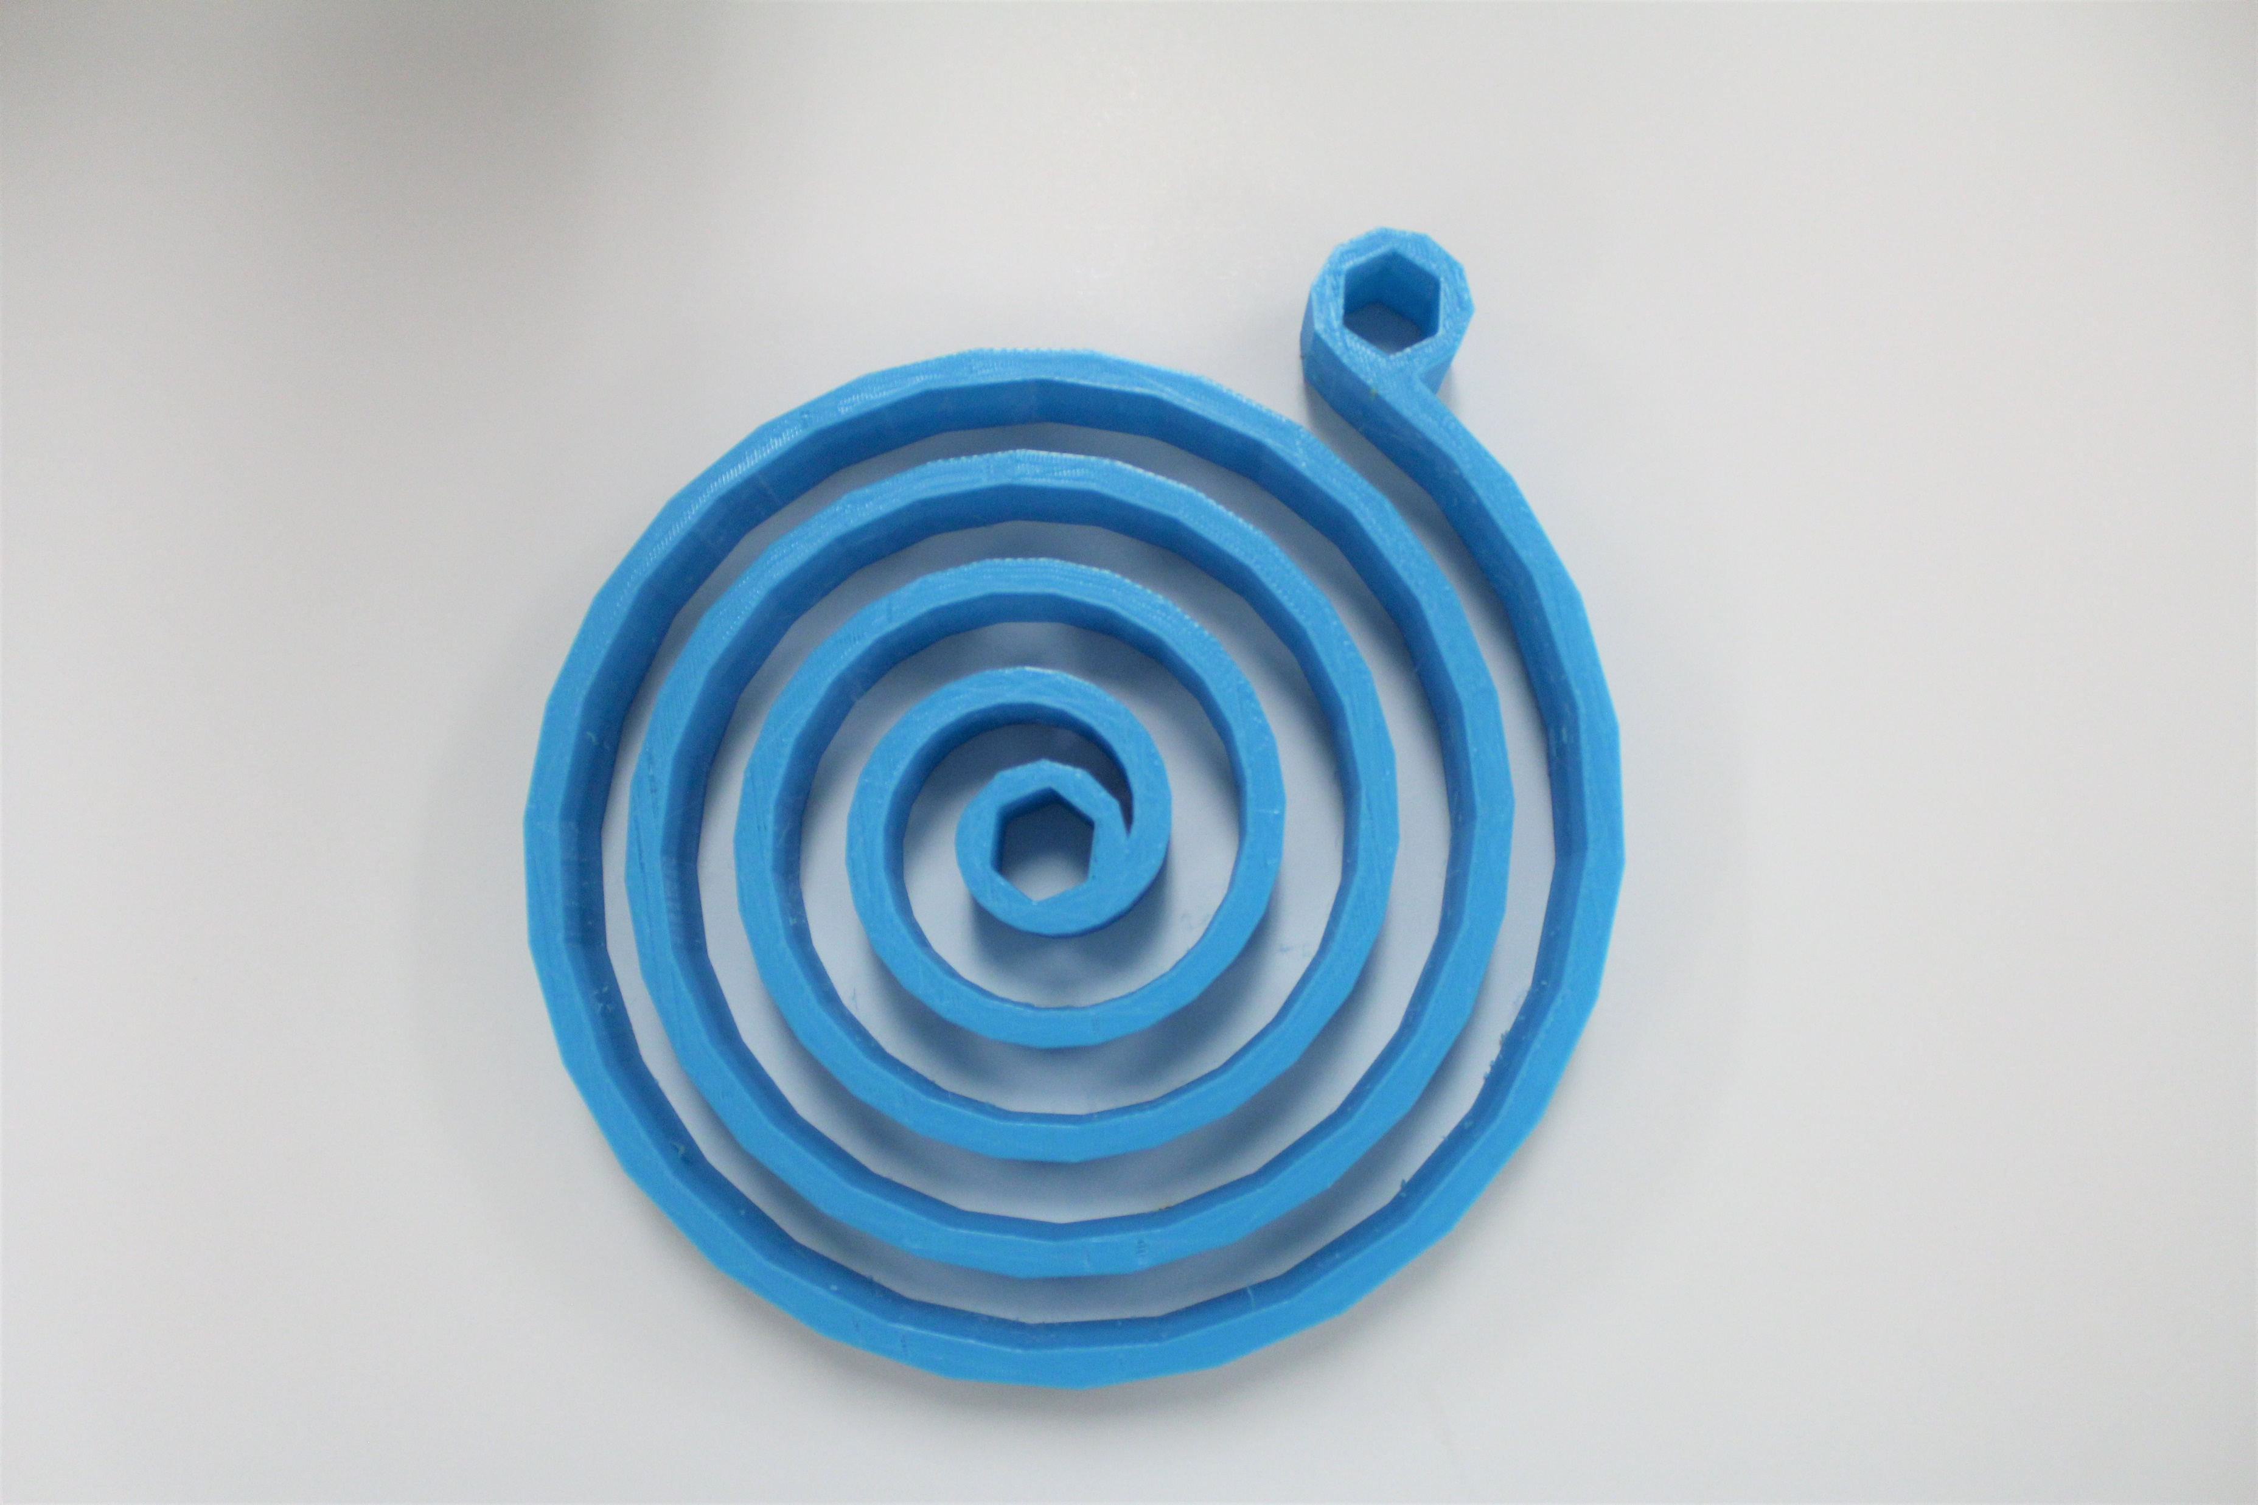
Prototype Testing
8in
Spiral torsion spring iteration no.1, printed with PLA at 10% infill.
Not heat treated. Weighs 4.5 oz.
1/7

Slide 86





Prototype Testing
Applied
Torque
Known
Weight
1.5 oz
3.7 oz
2.5 lbs
5 lbs
0: 0.0
2/7

Slide 87


Prototype Testing
1.5 oz
3.7 oz
2.5 lbs
5 lbs
Fracture Occurred
at 3.1 lbs
0: 0.0
3/7

Slide 88
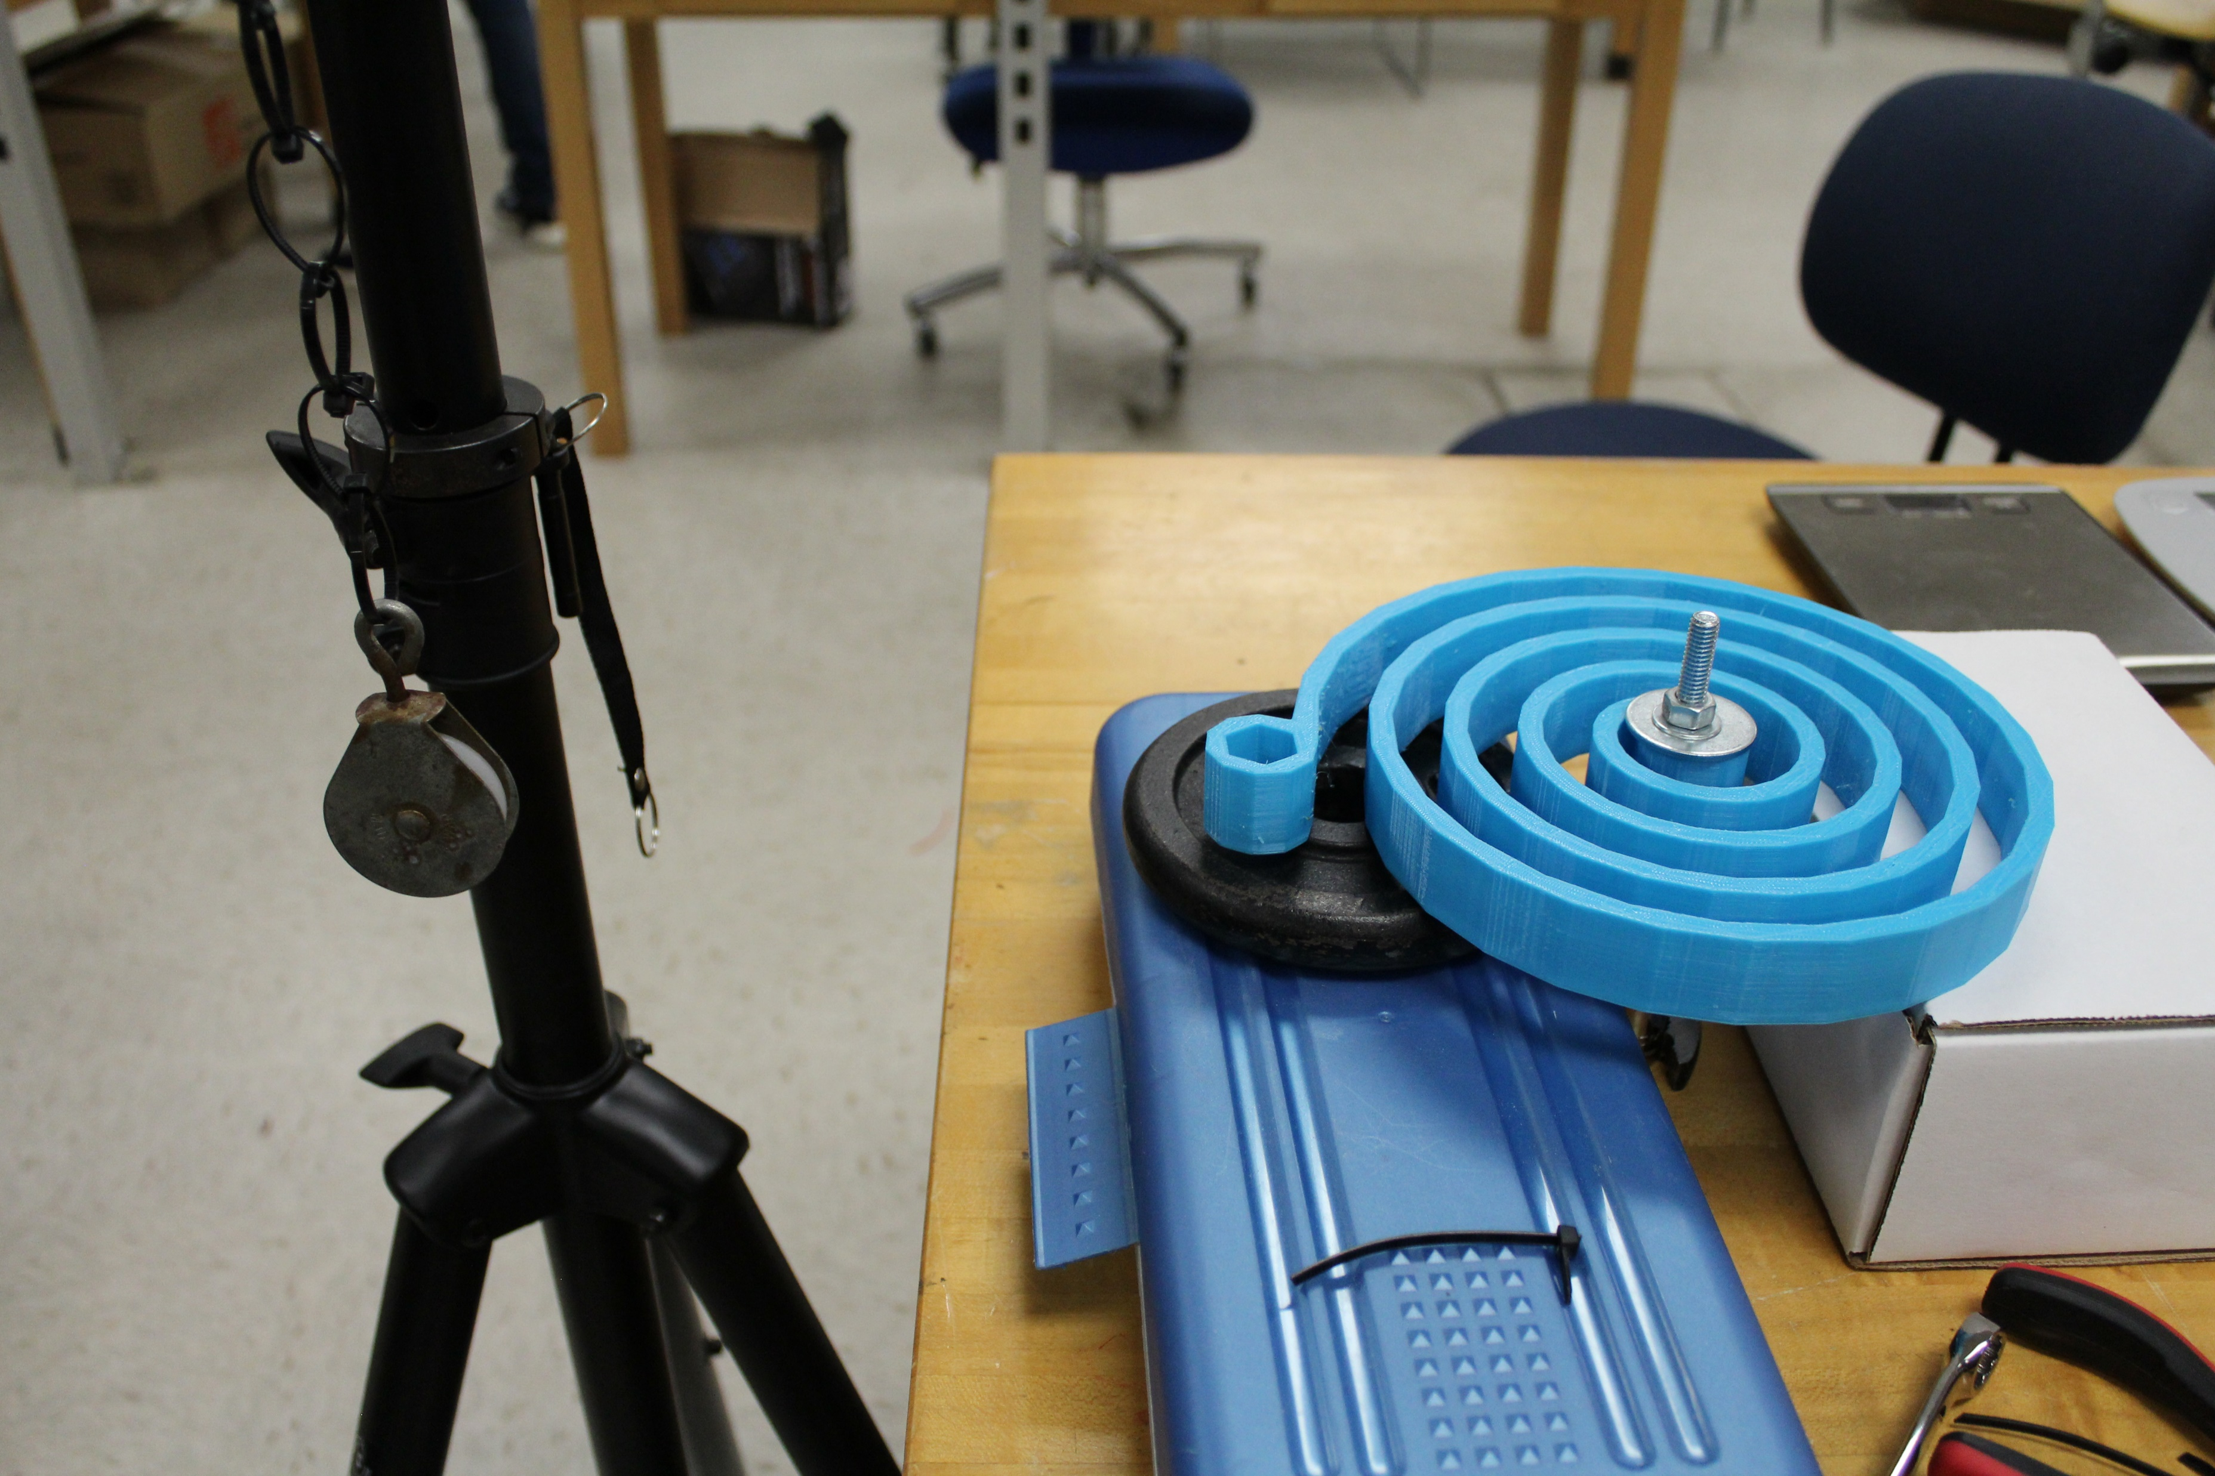
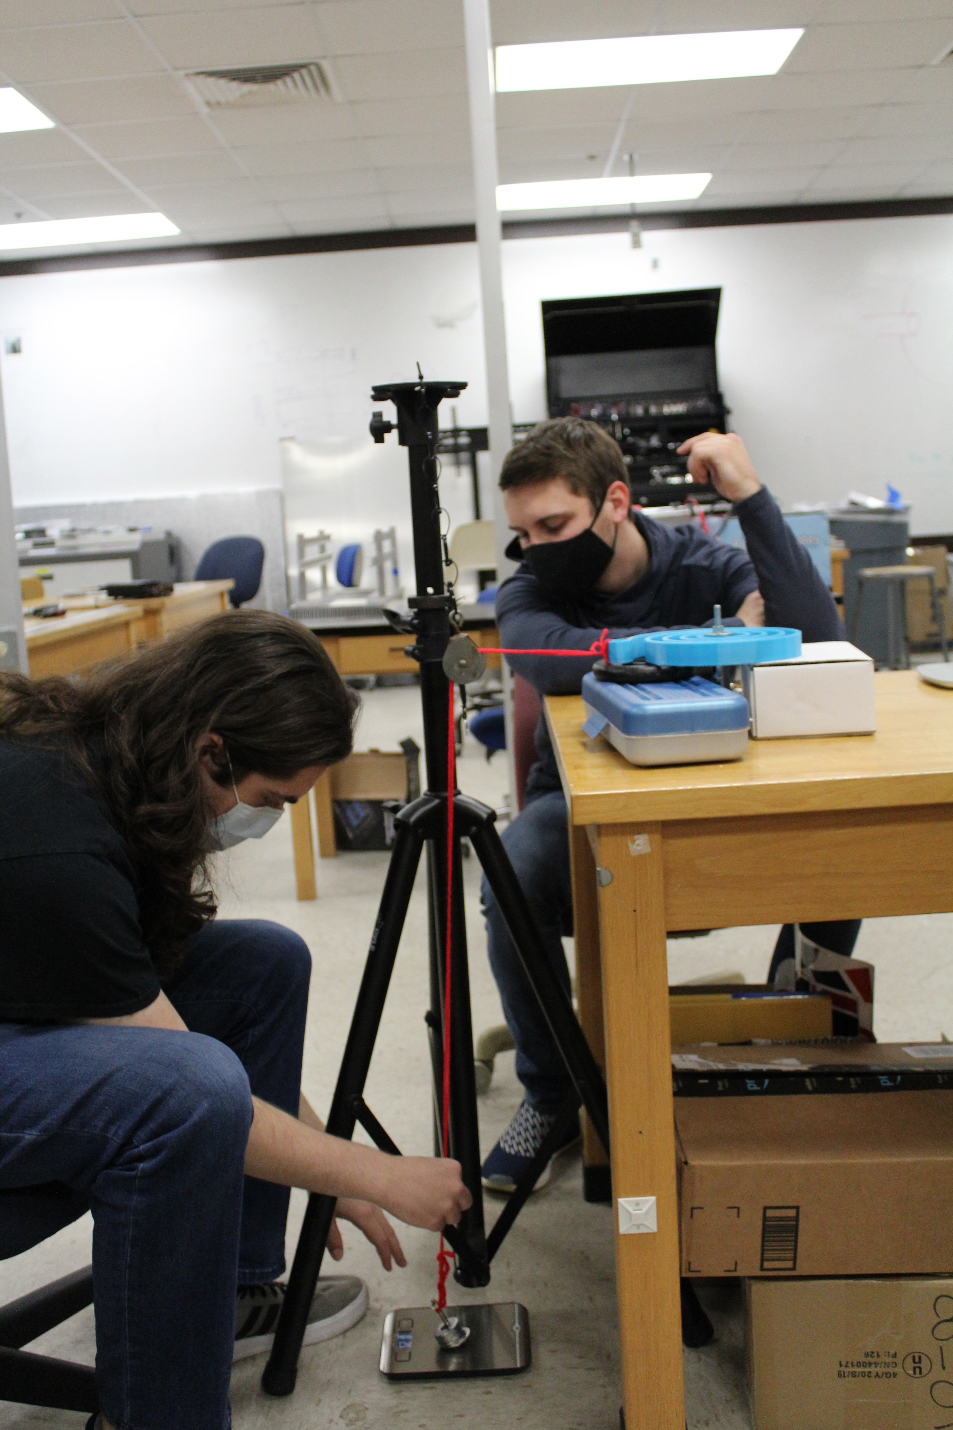
Testing Apparatus
Testing apparatus to gauge the strength of the 3D printed torsion spring.
4/7

Slide 89
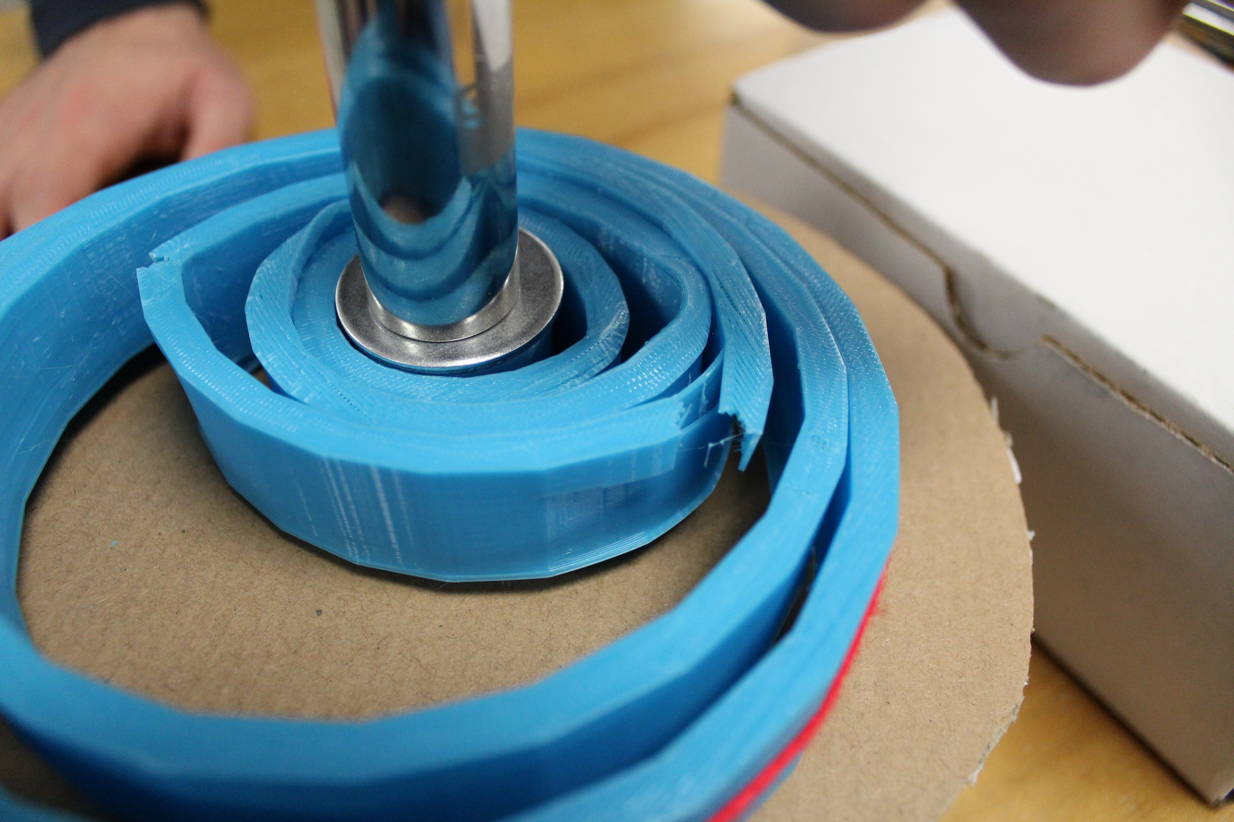
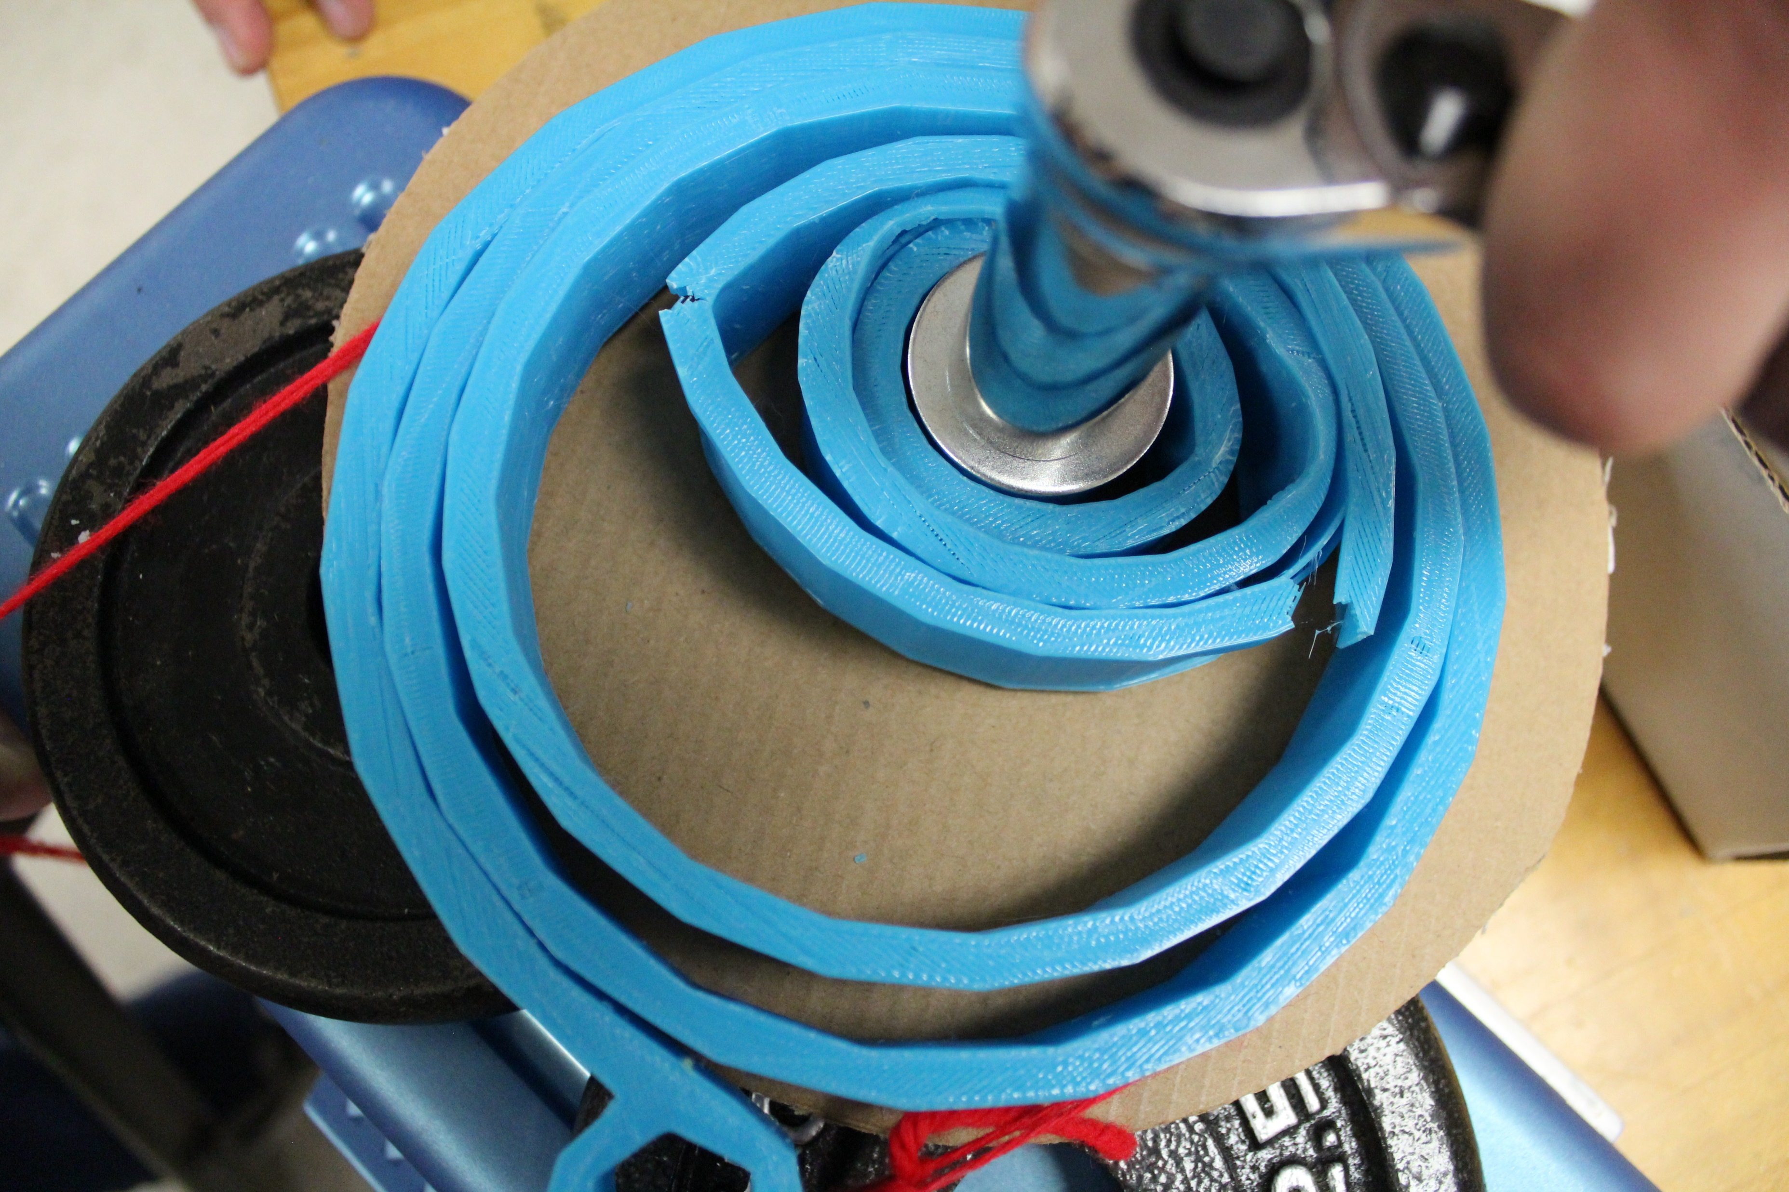
Fracture Point
Failure Occurred at 3.1 lbs
5/7
Notes:
Results, show fracture

Slide 90




Prototype Errors
LOW
INFILL
PRINT
INCONSISTENCIES
HEAT
TREATMENT
6/7

Slide 91



Testing Errors
WINDING
METHOD
STRING
ELASTICITY
PULLEY
FRICTION
SPRING
FLEX
DISPLACEMENT
ANGLE
7/7

Slide 92

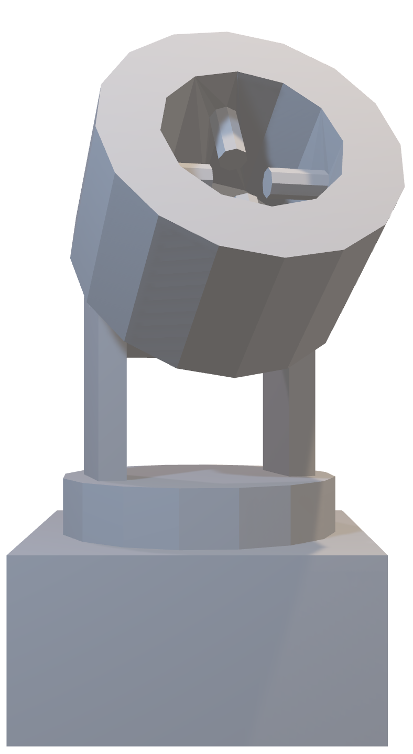
Initial Design
Connection Housing
Actuated Pins & Plug Connection
Revolution Axis
Gearbox and turntable powered through CLPS
lander
Turntable
Gearbox Housing
1/6

Slide 93
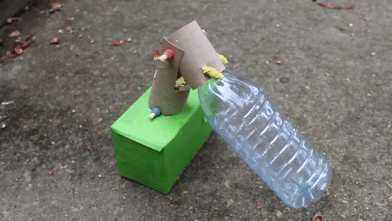
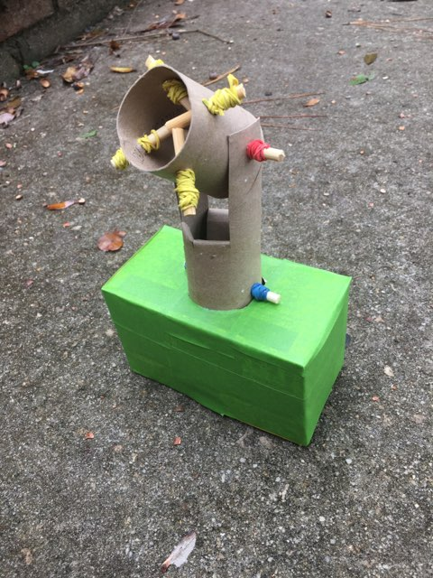
Rapid Prototype
NOTE: For demonstration, the LSMS is represented
using a plastic water bottle.
2/6
Notes:
Put reference axes

Slide 94
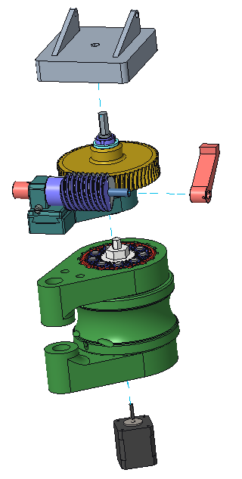




Design 1
1
Turntable / Connection Plate
mates with standard LSMS connector
1
2
Worm Gear Train – converts vertical rotation into horizontal rotation
2
3
3
Coupler Arm – initiates rotation about horizontal axis
4
4
Planetary Gear Train – provides a 160:1 torque ratio
5
Stepper Motor – powered through the lander
5
3/6

Slide 95
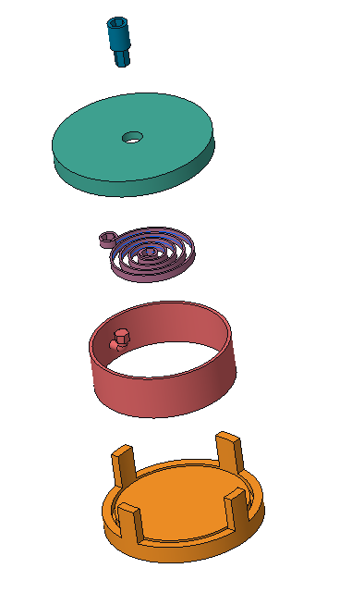
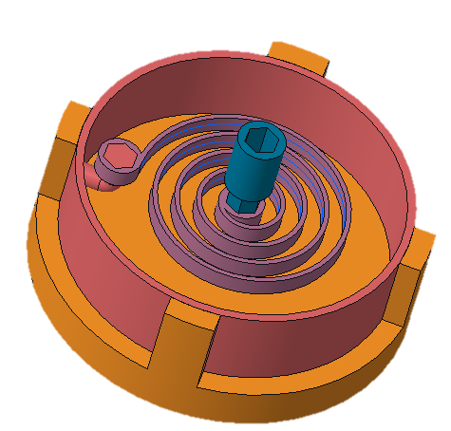




Design 2A
1
1
LSMS Hex Connection – input torque from LSMS winds spiral spring
2
2
Chassis Cover – covers and protects mechanism
3
3
Spiral Torsion Spring – initiates rotation about vertical axis
4
4
Rotational Cylinder – support at least 276 Nm of torque
5
Chassis Bottom – provides support to the slider, has some friction reducing/increasing measure
5
4/6

Slide 96
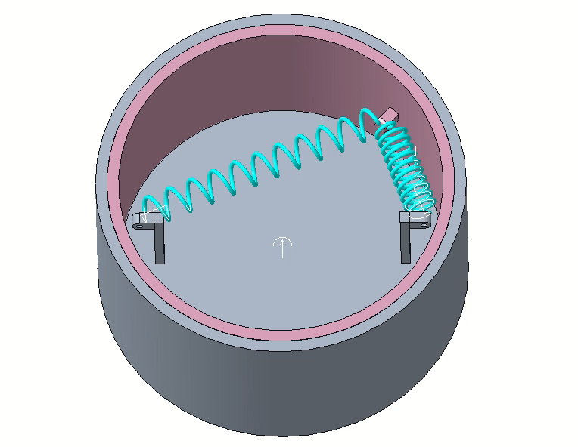
Design 2B
1
Chassis – acts as the ground and provides protection
2
Rotational Cylinder – rotates inside the chassis
3
Linear Tension Springs – initiates rotation about the z-axis
5/6
Notes:
8.5 inch diameter wheel
6 inch length spring
1.5 inch diameter spring
FOS 1.3. This was calculated from the 25lb weight requirement.
This test allowed us to see a rough estimation of how much space we would require for the spring to move without causing interference issues as it retracted.
Or something. BS til it works
NOTE: to replay the animation, hit the [Left Arrow Key] and then the [Right Arrow Key]

Slide 97

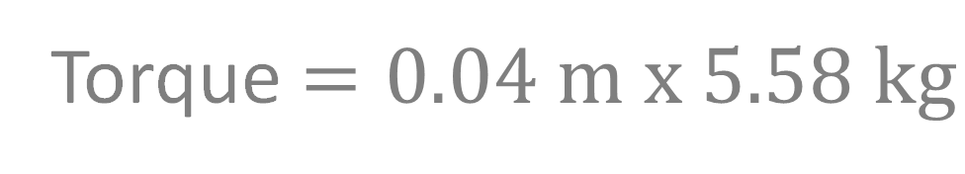


Forearm Torque
Same for Initial and Worst-Case Scenario
SHOULDER
KINGPOST
Forearm 0.65 Nm
5.58 kg
FOREARM
Torque $=r x F$
Torque $=0.04 m x 5.58 kg$
Torque $=19.0 Nm$
0.04 m
1/4

Slide 98
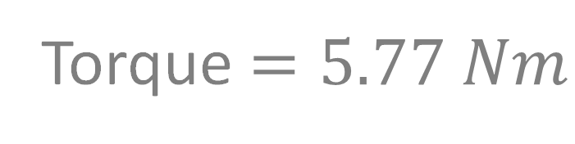
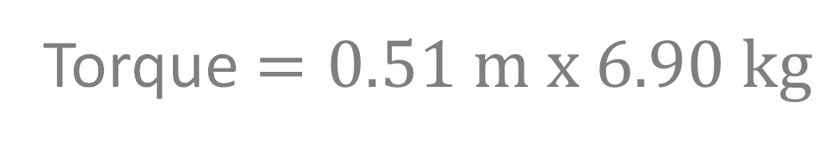
Shoulder Torque
SHOULDER
KINGPOST
Shoulder 5.77 Nm
FOREARM
6.90 kg
Torque $=0.51 m x 6.90 kg$
Torque $=5.77 Nm$
0.51 m
2/4

Slide 99


Free Body Diagram
Initial Position
12.5 kg
Kingpost 19.0-26.6 Nm
SHOULDER
FOREARM
Torque $=0.93 m x 12.5 kg$
Torque $=19.0 Nm$
KINGPOST
0.93 m
3/4
99

Slide 100


Kingpost Torque
Worst-Case Scenario Position
SHOULDER
KINGPOST
Kingpost 19.0-26.6 Nm
FOREARM
Torque $=1.31 m x 12.5 kg$
12.5 kg
Torque $=26.6 Nm$
1.31 m
4/4

Slide 101
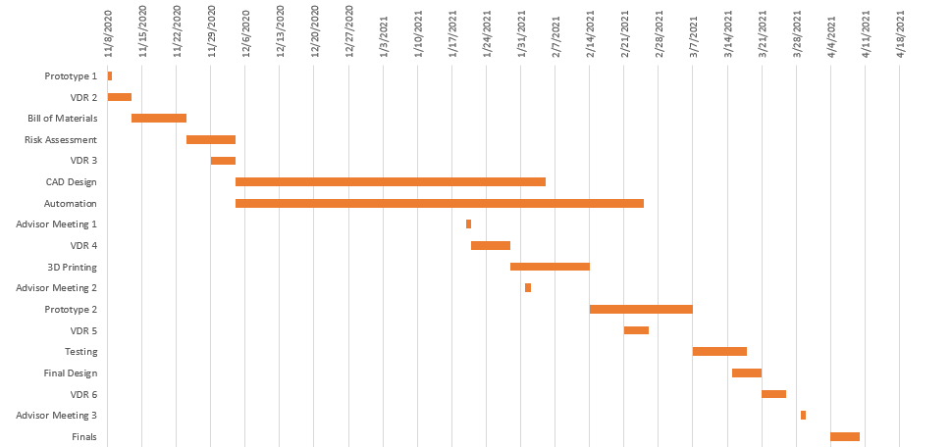
Gantt Chart

Slide 102

Color Palette

Slide 103

Team 517 Icons
Lunar Base Module
Straight Spring
Rotate about Z-axis
ARROW
LSMS
Peregrine Lander
Mobility Chassis
1.9m
Ryker

